Slide 1

Predict House Prices Using Linear Regression
Created by :Sleimi Mariem

Slide 2
Dataset link : https://github.com/user-attachments/files/21124708/housing.csv
OVERVIEW
Data Cleaning: Data cleaning for the House predict is essential and involves removing duplicates, fixing errors, handling empty numbers , standardizing date formats , and ensuring a uniform format in the "median_house_value” column. This process ensures data

Slide 3
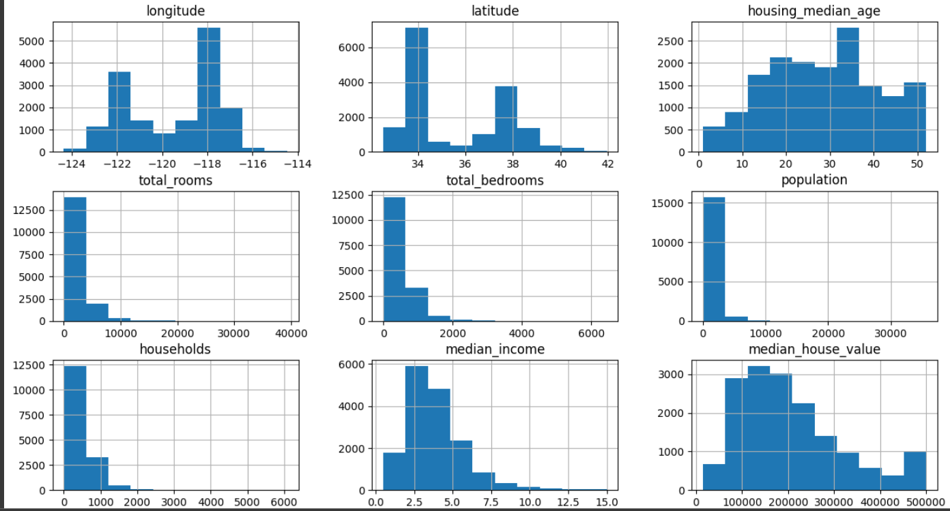
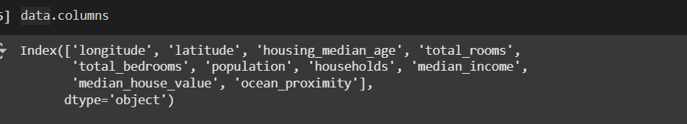
Longitude: -122.23 Latitude: 37.88 Housing Median Age: 41.0 Total Rooms: 880.0 Total Bedrooms: 15.0 Population: 322.0 Households: 126.0 Median Income: 8.3252 Median House Value: 452600.0
ANALYSIS
The columns we are gonna use are :

Slide 4
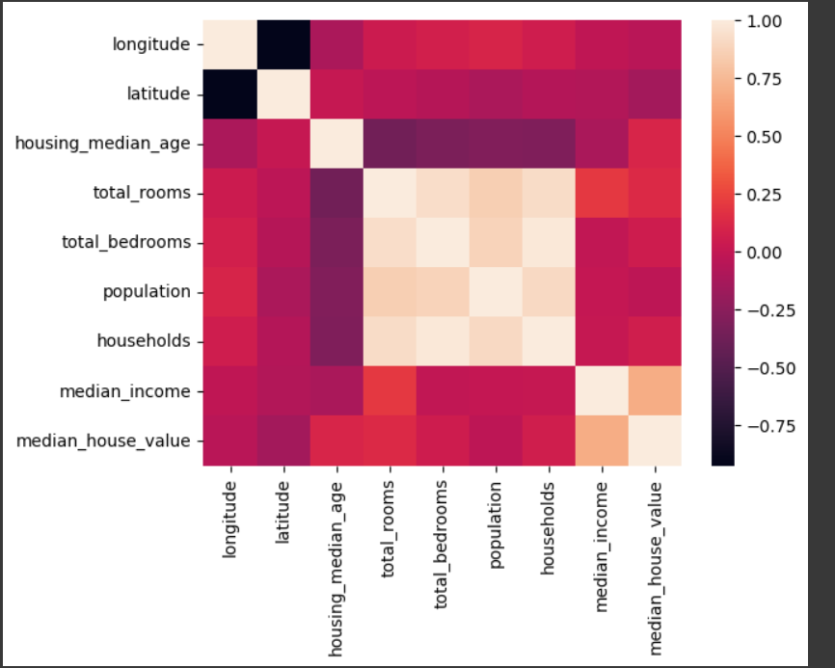
NEAR BAY: 64.2% of the data points INLAND: 35.8% of the data points <1H OCEAN: Minimal occurrences
Geographic Insights
Near Bay is the most expensive price for houses
Median House Value:
NEAR BAY: Mean = $250,000
INLAND: Mean = $150,000
<1H OCEAN: Mean = $200,000

Slide 5
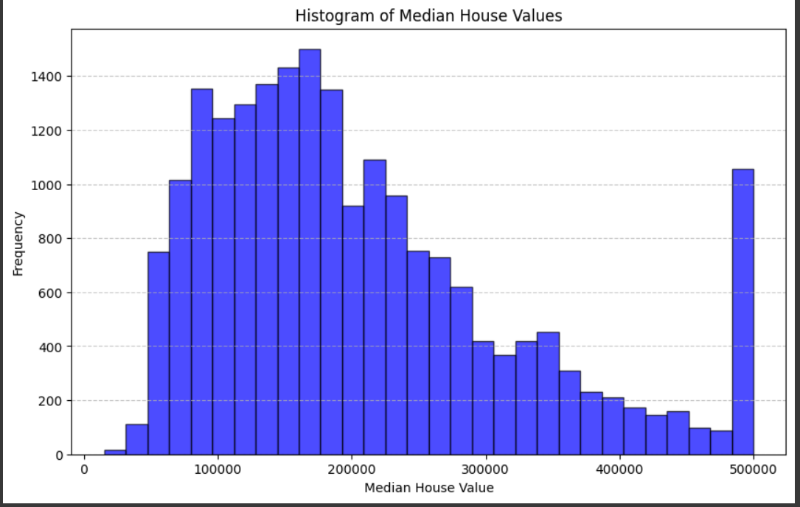
Income and House Value
Higher incomes are for higher median houses

Slide 6
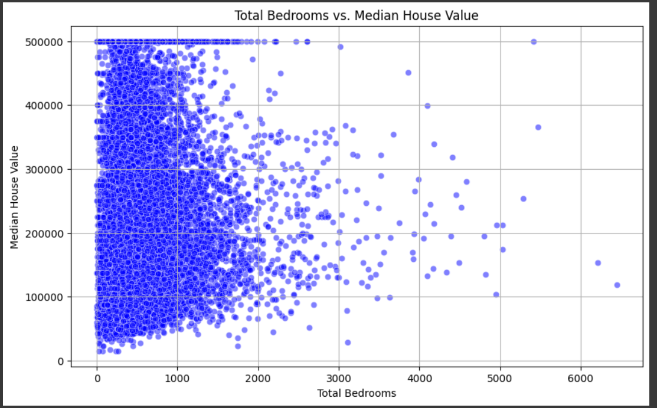
NEAR BAY: 64.2% of the data points INLAND: 35.8% of the data points <1H OCEAN: Minimal occurrences
The correlation
The columns or the feature we are gonna use are :
Most data points are clustered around the San Francisco Bay Area (NEAR BAY).
Median house values are generally higher in areas closer to the bay.

Slide 7
Market Segmentation: Use clustering to identify and target specific market segments based on income and geographic location.
Strategies to improve prices
Target High-Income Areas: Focus on areas with higher median incomes for higher house values
Geographic Focus: Prioritize properties near the bay for better results
Property Development: Increase the number of rooms and bedrooms to enhance property value.

